Slide 1
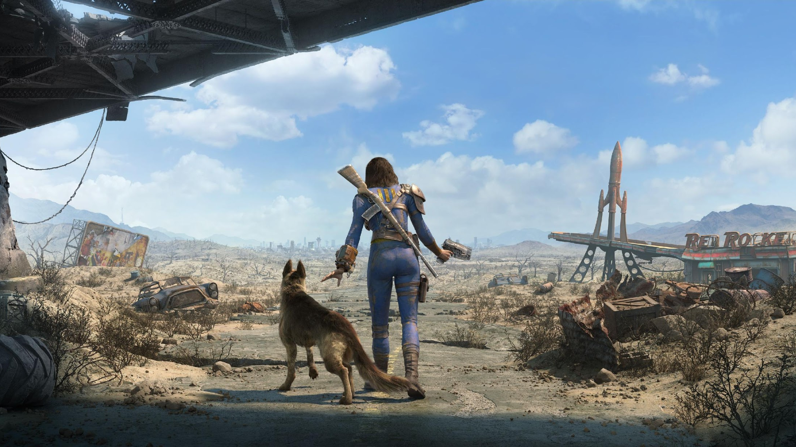
ROLE ASSIGNMENT THROUGH NATURAL LANGUAGE
Notes:
Hello all,
We are going to present you the application we developed for our Watson Assistant. For this project we wanted to go for a different approach, so instead of making Watson answer user queries, we wanted him to ask the questions with the purpose understanding our clients and increase our chances of giving them a better experience when playing with an RPG game.

Slide 2
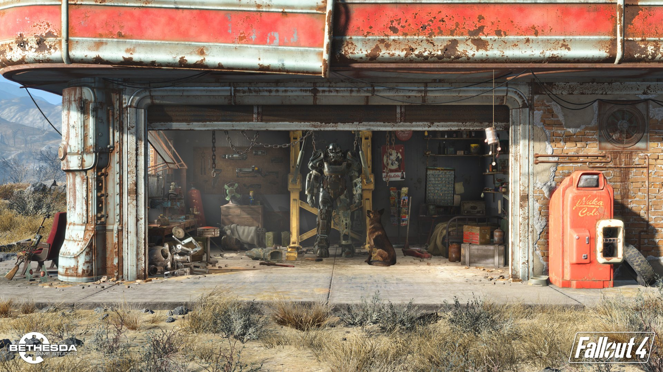

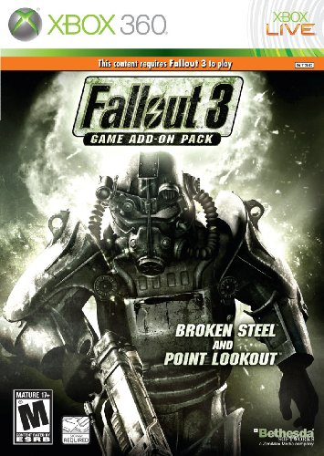
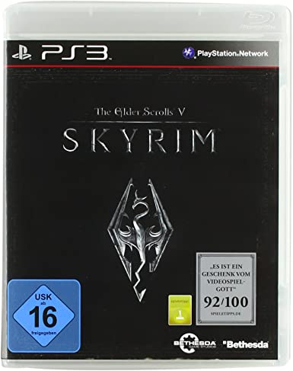
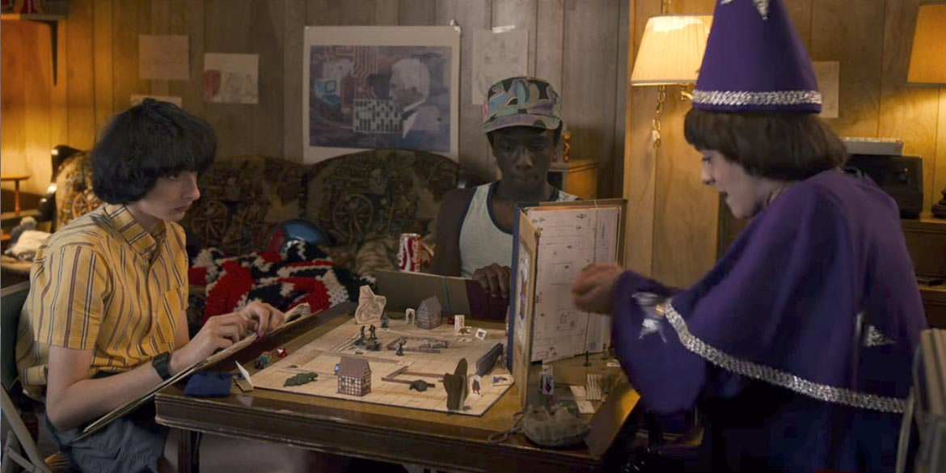
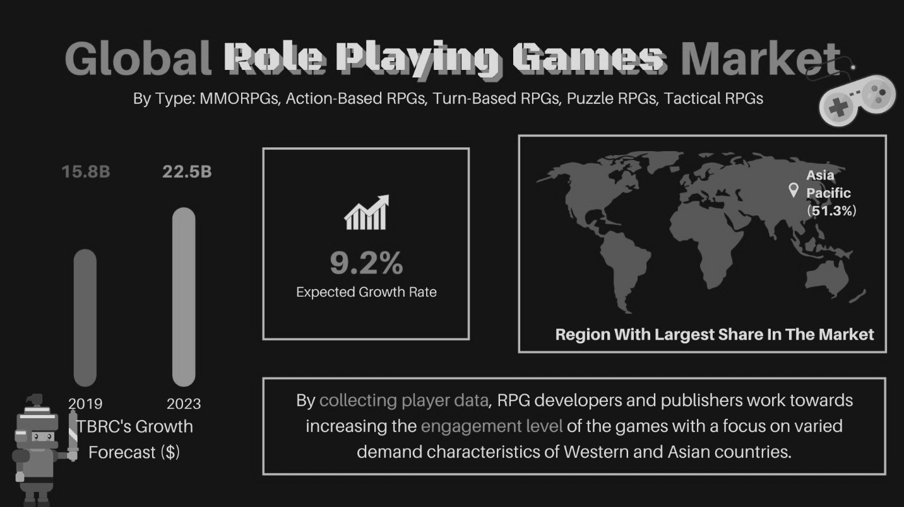
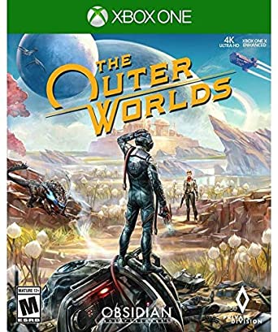
WHAT IS A ROLE PLAYING GAME?
In Role Playing Games (RPGs), players assume the roles of characters in a fictional setting, either by acting or by making decisions
Market size forecast (2023)
22,5 B$
Tabletop RPGs
RPG Videogames
Region with largest share:

Slide 3


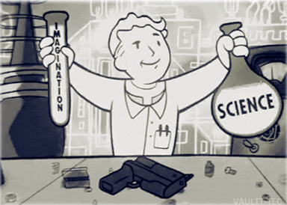


THE CHARACTER CREATION PROBLEM
Little knowledge at the beginning of game
THAT CAN BE IMPROVED!
Introducing the AI assisted…
Unimmersive process
Notes:
Now, most RPGs will start with the character creation. This step will define our avatar in the fictional world, and therefore highly influence the rest of the experience. Unfortunately this critical step happens exactly in the moment when you know less about the game. So you might end up making a decision you may regret after you have already invested several hours playing the game.
[CLIC]
Also this is usually achieved in an not immersive way by asking you to distribute points in several characteristics as if you were just parametrizing a human being.
But maybe we can improve this with AI… What if we could interact with players and understand how would they like to play the game? We could use Natural Language to get richer information and better adapt the experience.
In this project we have tested this possibility by creating a chatbot that will acquire information from users in the context of the game, and for the example we chose the RPG “Fallout 3”.
In the beginning of this game, players will be a kid who lives on an underground Vault, in a world that has been devastated by nuclear Armageddon. At age 16 they are supposed to undertake the “Generalized Occupational Aptitude Test” (GOAT) in order to assign them a role in the Vault. We use this text as an immersive way to gather information. With the results we will suggest the player the most appropriate character settings for his/her style.

Slide 4


>> G.O.A.T.

Slide 5


>> 10-question test receiving natural language.
>> Associates intents and entities with skills.
>> Gives the user the optimal skill point distribution.

Slide 6


>> Variables:
points = total points to distribute.
user_input = user’s NL answer.
>> Lists:
skillList = fallout skills.
entitiesList = entities.
entitiesList_clean = final list of entities.
>> Dictionaries:
message_input = user_input in watson format.
response = from watson’s json package.
roleDict = final roles and descriptions.
skillDict = user’s skills and their levels.

Slide 7
- Dictionaries -
skillDict = {
'WeaponsSmallGuns':9,
'Dialogue':9,
'Medicine':9,
'Negotiate':9,
'Repair':9,
'Science':9,
'Sneak':9,
'UnarmedCombat':9,
'WeaponsBigGuns':9,
'WeaponsShortRange':9
}
roleDict[‘Science’] = ["Pip-Boy programmer","Well, well. Pip-Boy Programmer, eh? Stanley will finally have someone to talk shop with.", "Your knowledge will allow you to go around risky situations, keep reading every book and magazine you can find to master other skills"]

Slide 8

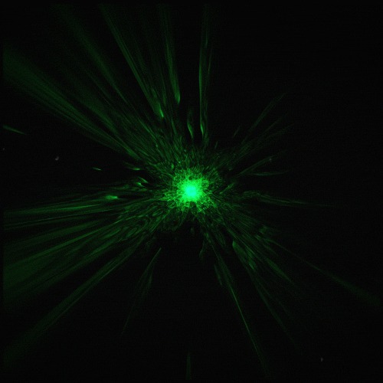
>> Main loop:
1. Communicates with Watson assistant.
2. Detects intents.
3. Responds and calculates results.
4. Prompts the next question.

Slide 9
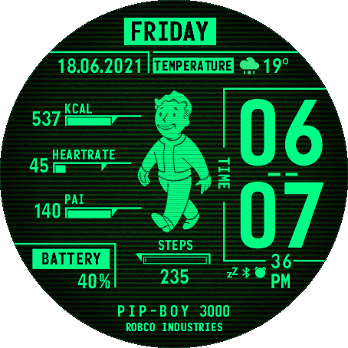
- Functions -
>> def Return Entities:
Makes a list of all entities detected in the answer.
Appends that list to the global entities list.
>> def Assign Points:
Calculates valid answers andweights entities.
Assigns the corresponding proportion of points.
Leftovers are assigned randomly.
>> def Assign Role:
Assigns role according to the skill distribution.

Slide 10
- Return Entities -
def returnEntities (response, entitiesList):
entities=[]
for i in range(len(response['output']['entities'])):
entities.append(response['output']['entities'][i]['entity'])
entitiesList.append(entities)
return entitiesList

Slide 11
- Assign Role -
def assignRole (skillDict):
maxValue = 0
for skill in skillDict:
if skillDict[skill] > maxValue:
maxValue = skillDict[skill]
roleSkill = skill
print ('')
print ('You will be our next', roleDict[roleSkill][0])
print (roleDict[roleSkill][1])
print ('')
print ('Points per skill: ')
print (skillDict)
print ('HINT',)
print (roleDict[roleSkill][1])

Slide 12
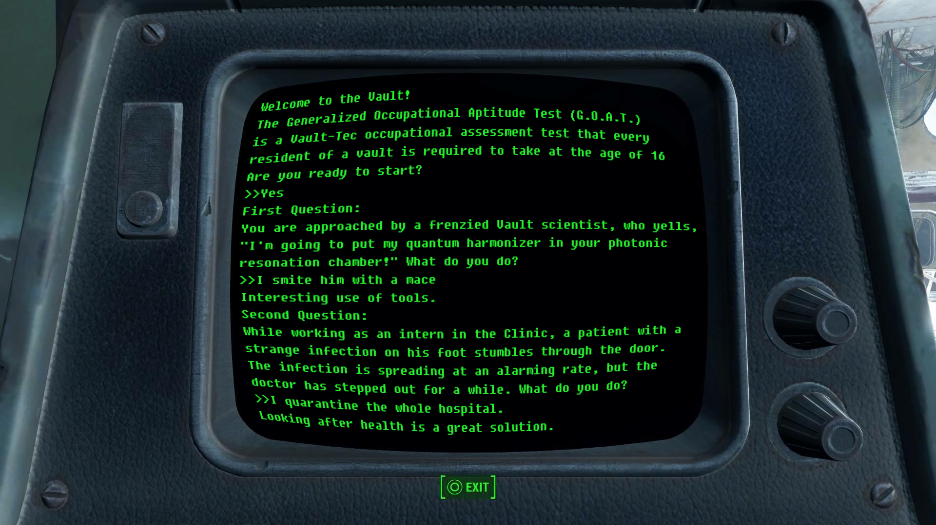

Slide 13
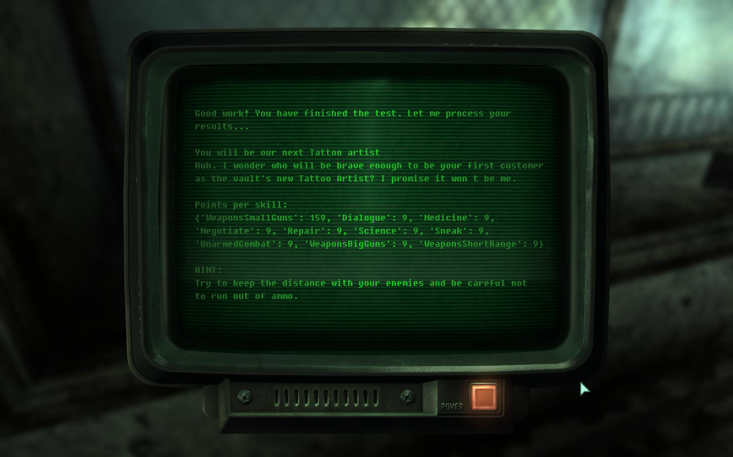

Slide 14

BUSINESS CASE

Slide 15
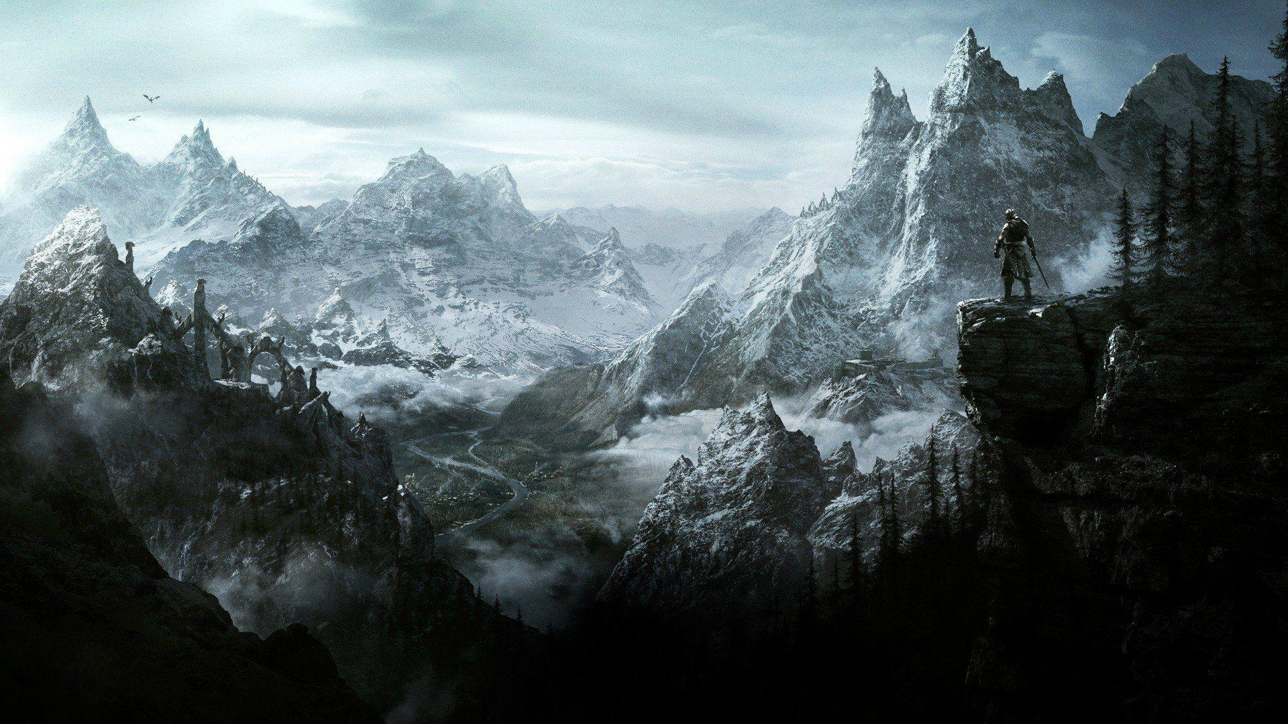
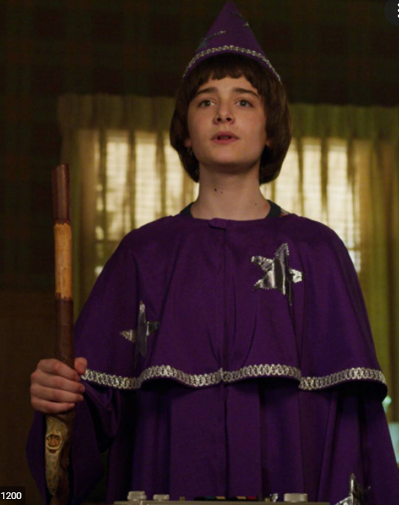

INCOME SOURCE 1: SELL INFORMATION ABOUT POTENTIAL CUSTOMERS TO GAMING COMPANIES
1
2
Will is the master of Fallout and he has the board game
Will plays the game with Dustin, Mike and Lucas
Windows doesn’t know Dustin, Mike and Lucas also play the game.
They are potential customers since they like this kind of games.
Windows has some information about Will:
Name
Address
but nothing further than public information

Slide 16

With our chatbot’s data the gaming companies could….
Gather personal information
Discover customer profiles
Predict customer behaviour and recommendation engine
Reduce costs
If the people who play with Mike use the bot, we can gather their information and behaviours in different situations.
Segmentation with the ways a person react to situations.
Known which games will be trendy for the next season
Give game recommendations or develop new types of games.
With the data gather by the bot, in house market research can be executed.

Slide 17
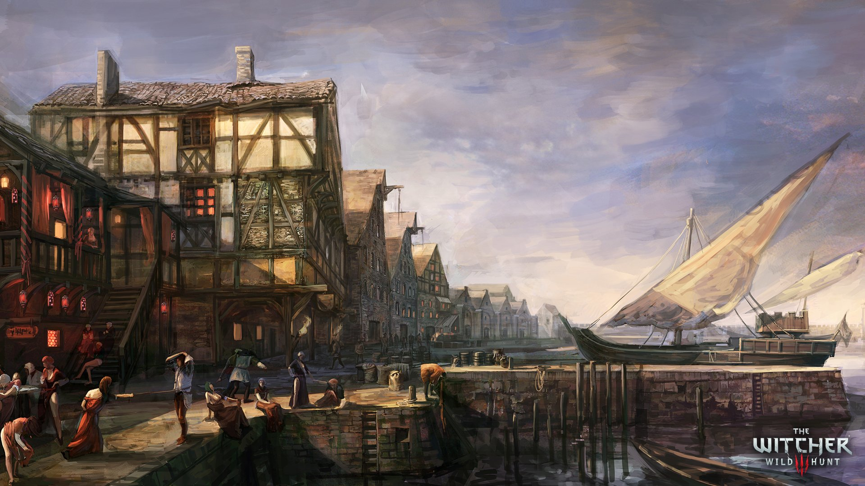
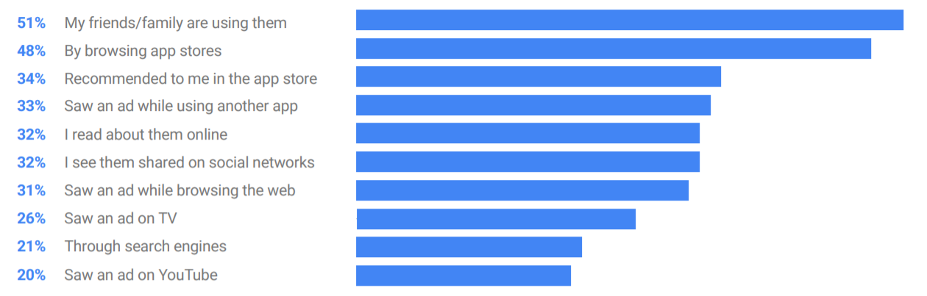
INCOME SOURCE 2: ADVERTISING
BUILD A COMMUNITY
>> RPG community is already huge, lets help it grow.
>> Only in Fallout, there is an average of 17.000 players per month.
>> To get recommendations related with how to play, people have forums or see youtube gamers with the same issues.
>> If you convince the community, you can succeed in the industry!
Use of two types of ads:
Banner ad
Interstitial ad
The idea is not overwhelm the customer, but show game related things.

Slide 18

POTENTIAL REVENUE
>> According to Google AdSense, $0.05 per view. This number increases with click-per-views on ads.
>> Establishing partnerships with game creators, and growing a larger audience increases revenue
exponentially.
Example: QR code in board games redirecting them to the chatbot for profile creation
>> Data generated can be sold.
>> Recommend games adapted to user responses and overall profile, providing an amazon link to purchase.
>> If a deal is made with the company that for each purchase through the link a commission fee is recieved.
>> Partnerships with online content creators for tabletop games like Dungeons & Dragons. In exchange for
promoting the chat bot, the bot would suggest their videos after a user makes their profile.
>> Easily deployable. The simplicity allows it to not require much maintenance and server costs. Advantage
of being adaptable to more complex interactions OR simple Q&A interactions.
Notes:
ASSUMing a player base of 15M active players, 750,000 would reflect a 5% of that audience. D&D alone has 13.7 million. $37,500 at $0.05 cents.
According to Google Ad Sense, This number increases with click-per-views on ads.
Furthermore, the data generated can become of great value to designers and developers, through machine learning programs you could analyze the probability of players picking a specific profile, as well as analyze the overall population of the player base in order to balance game mechanics.
Assuming we would be able to grow a larger audience as well as establish partnerships with game creators, revenue rise exponentially. An easy way this could achieve both is through a QR code in board games redirecting them to the chatbot for profile creation.
Moreover, the bot can recommend games adapted to your responses and overall profile and provide you the amazon link to the games. If a deal is made with the company that for each purchase through your link you receive commission fee.
Easily deployable, and the simplicity allows it to not require much maintenance and server costs.
There are even several YouTube Channels for tabletop games like Dungeons & Dragons where in exchange for promoting the chat bot, the bot would suggest their videos after a user makes their profile.
potential further uses, personality test (could be useful for companies or universities), psychological tests for the mental health industry

Slide 19
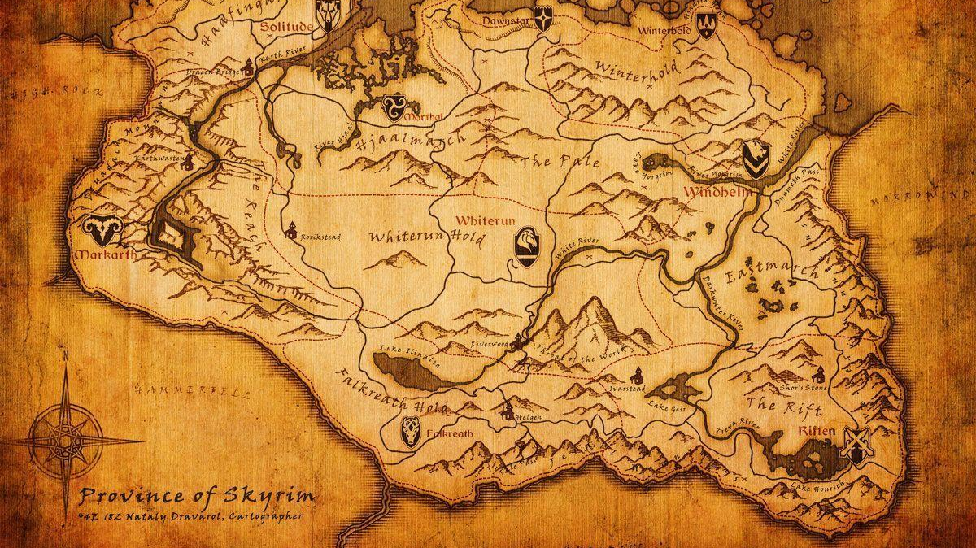
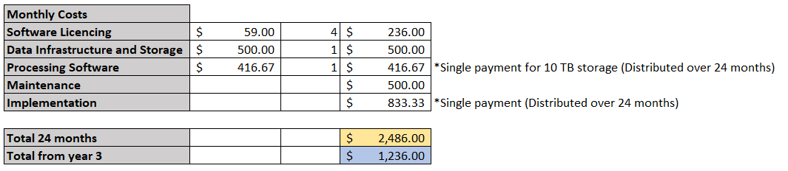
POTENTIAL COST
Costs for the Business
Software costs: The business would need the necessary applications to store and process the data to be able to sell high quality, structured data.
Implementation: At the beginning of the operations, investment to acquire the storage and implementations of softwares will be higher.
Assuming 4 employees with licences that can monitor system and data.

Slide 20
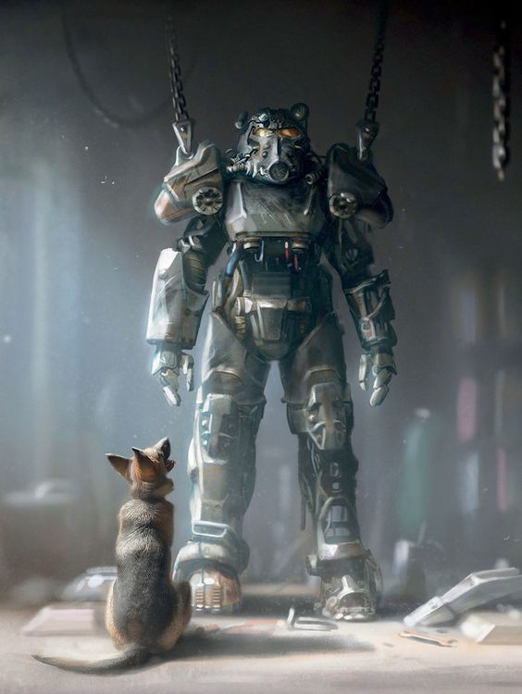

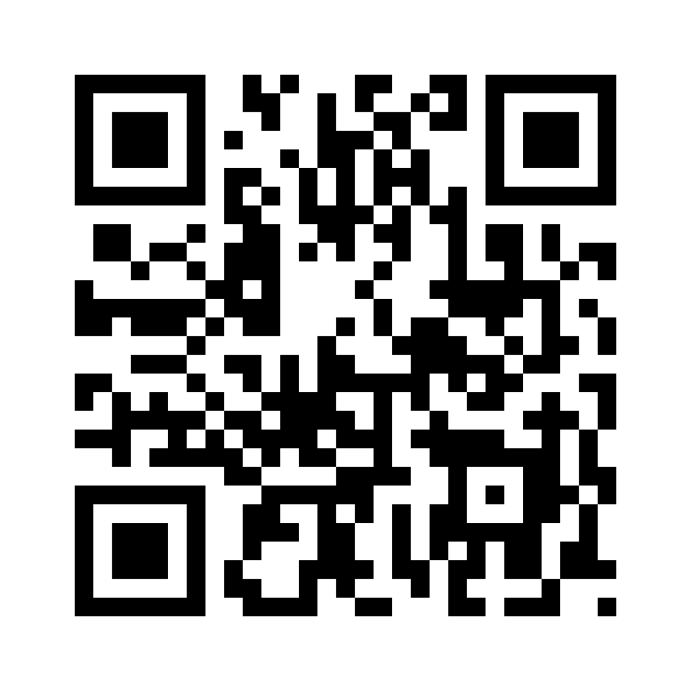


Powered by RoleApp

Slide 21
THANK YOU!
Questions?

